Slide 1
Cohort study of HIV+ children in Southern Africa returning to care after being lost to follow up: Effect of interrupting care on mortality
26th July 2018

Slide 2
Introduction
Loss to follow up in children presents us with challenges: Unknown medication use, no clinical or laboratory monitoring
Increasingly, children are later returning to care, called a care interruption
Little is known of the long-term outcome of a care interruption, and timing of the care interruption after ART start

Slide 3
objectives
Describe the characteristics of children with a care interruption, and compare them to children that remained on treatment
Describe the characteristics of the period of loss in children with a care interruption
Evaluate the association between a care interruption and mortality

Slide 4
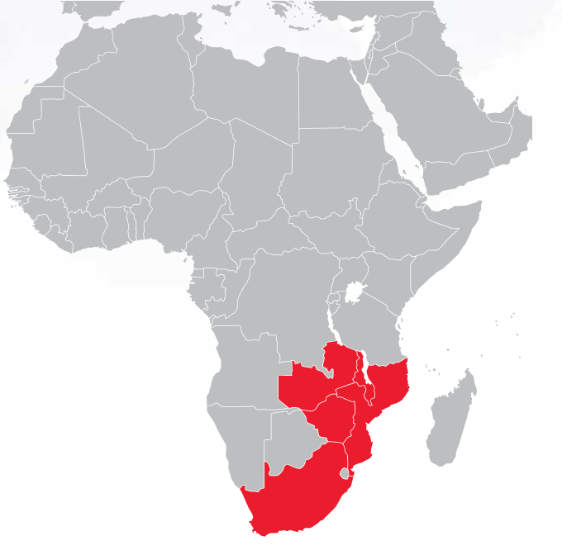
Iedea southern africa
Period of study: 2004 - 2016
126 clinics across 6 countries: Lesotho, Malawi, Mozambique, South Africa, Zambia, and Zimbabwe
Number of children in study: 46,356
Number of person-years: 180,446
Age range of children: birth to <16 y
Number of children who died: 1,393

Slide 5
timeline
Start ART treatment
46,356
No care interruption: 22,076
6 months
Group 1
Group 2
Lost in the first 6 months on ART and later returned:
10,998 (24%)

Slide 6
timeline
Start ART treatment
46,356
6 months
Group 1
Group 2
Group 3
Lost after 6 months on ART and later returned:
13,282 (29%)

Slide 7
METHODS
Main outcome of all cause mortality
Care interruption was defined as the first period of no visit for >180 days
Inclusion criteria:
Treatment-naïve (baseline HIV-RNA >400 copies/ml)
<16 years old initiating ART between 1 January 2004 and 2016
Alive for at least 180 days after ART initiation
Poisson regression model with robust standard errors, controlling for confounding

Slide 8
Methods: person-time allocation
Child starts ART
Child hasn’t returned to clinic for 180 days: care interruption (theoretical clinic date)
Database closes/ Child dies
180 days
Clinic visits
Child attends regular clinic visits
Child returns to clinic
Group 1: Time before a care interruption
Group 2/3: Time after a care interruption

Slide 9
Characteristics of children with an interruption
Characteristic | Total | Care Interruption status
 |  | No Care interruption (CI) | CI before 6 months | CI after 6 months
 | N | N (%) | N (%) | N (%)
 | (n = 46,356 ) | (n = 22,076 ) | (n = 10,998 ) | (n = 13,282 )
Sex
Male | 22,712 | 10,737 (49) | 5,410 (49) | 6,565 (49)
Female | 23,644 | 11,339 (51) | 5,588 (51) | 6,717 (51)
Median (IQR) age at ART initiation | 6.0 (2.2-10.1) | 5.9 (2.1-10.1) | 5.6 (1.9-9.9) | 6.3 (2.6-10.2)
Median (IQR) CD4% initiation | 15.0 (9.6-22.6) | 15.0 (9.3-22.2) | 16.5 (10.7-24.5) | 14.8 (9.3-22.0)
Year of ART initiation
2004-2007 | 12,786 | 5,516 (25) | 2,830 (26) | 4,440 (33)
2008-2009 | 10,286 | 4,636 (21) | 1,858 (17) | 3,792 (29)
2010-2011 | 10,555 | 4,565 (21) | 2,586 (24) | 3,404 (26)
2012- | 12,729 | 7,359 (33) | 3,724 (34) | 1,646 (12)

Slide 10
Characteristics of interruptions
Characteristic | Group 2: Lost in the first 6 months on ART and later returned | Group 3: Lost after 6 months on ART and later returned
Length of first interruption (median) | 322 days | 244 days
Proportion of follow-up time lost (median)* | 71% | 30%
Percentage ultimately lost when the database closed | 50% | 35%
* Calculated as Length of time out of care/ Total follow-up time

Slide 11
effect of a care interruption on mortality
Variable | Adjusted RR* (95% CI) | P-value
CI status
No Care Interruption | 1.00 | <0.001
Care Interruption before 6 months | 3.23 (2.56 to 4.08)
Care Interruption after 6 months | 1.19 (0.91 to 1.56)
Current Age
<2 years | 1.00 | <0.001
2-5 years | 0.27 (0.20 to 0.36)
6-9 years | 0.10 (0.07 to 0.14)
>=10 years | 0.05 (0.03 to 0.08)
Age at ART initiation
<2 years | 1.00 | <0.001
2-5 years | 1.08 (0.83 to 1.40)
6-9 years | 2.19 (1.50 to 3.20)
>=10 years | 5.21 (3.37 to 8.06)
Year of ART initiation
2004 – 2007 | 1.00 | <0.001
2008 – 2009 | 0.83 (0.69 to 0.99)
2010 – 2011 | 0.59 (0.47 to 0.74)
2012 – 2016 | 0.36 (0.26 to 0.49)
* Also adjusted for gender, time in/out of care, baseline CD4% at ART initiation, cohort

Slide 12
effect of a care interruption on mortality
Variable | Adjusted RR* (95% CI) | P-value
CI status
No Care Interruption | 1.00 | <0.001
Care Interruption before 6 months | 3.23 (2.56 to 4.08)
Care Interruption after 6 months | 1.19 (0.91 to 1.56)
Current Age
<2 years | 1.00 | <0.001
2-5 years | 0.27 (0.20 to 0.36)
6-9 years | 0.10 (0.07 to 0.14)
>=10 years | 0.05 (0.03 to 0.08)
Age at ART initiation
<2 years | 1.00 | <0.001
2-5 years | 1.08 (0.83 to 1.40)
6-9 years | 2.19 (1.50 to 3.20)
>=10 years | 5.21 (3.37 to 8.06)
Year of ART initiation
2004 – 2007 | 1.00 | <0.001
2008 – 2009 | 0.83 (0.69 to 0.99)
2010 – 2011 | 0.59 (0.47 to 0.74)
2012 – 2016 | 0.36 (0.26 to 0.49)
* Also adjusted for gender, time in/out of care, baseline CD4% at ART initiation, cohort

Slide 13
Sensitivity analysis: Interruption Length
Sensitivity analysis adjusting the duration of care interruption in those with a care interruption within 6 months on ART

Slide 14
Sensitivity analysis: time on art
Figure 1: Sensitivity analysis of the time on ART prior to a care interruption

Slide 15
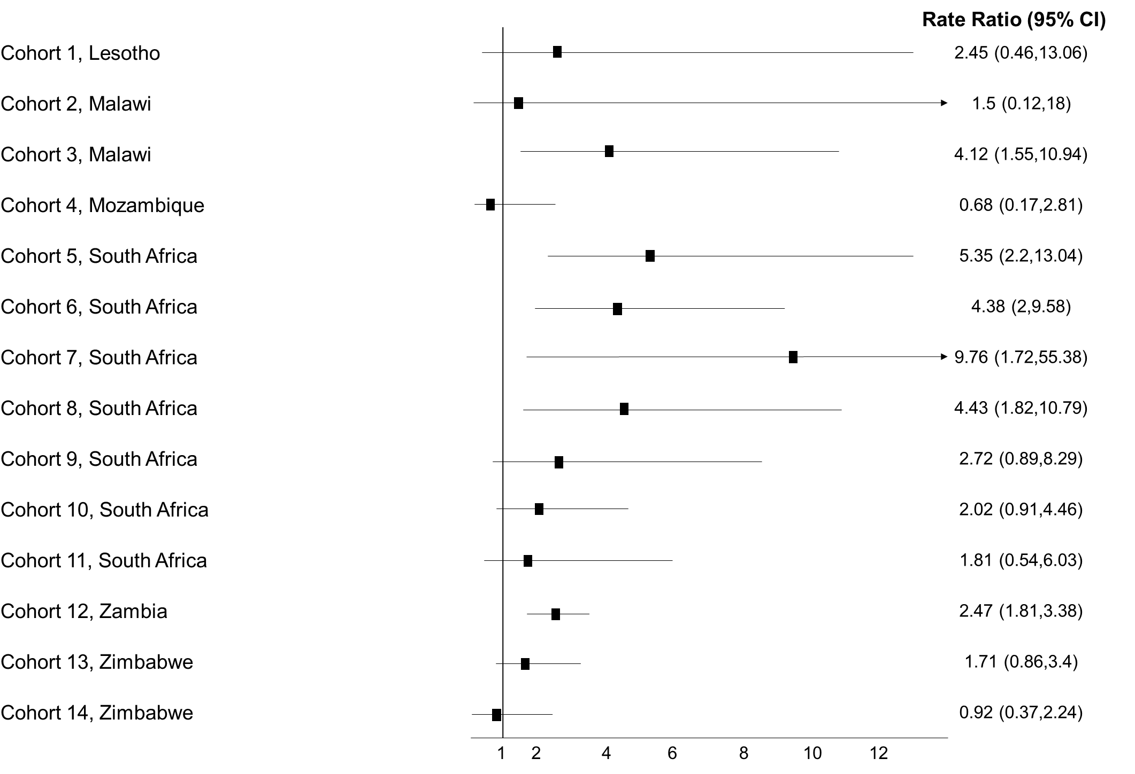
Cohort analysis

Slide 16
implications
Care interruptions are important
Need to strengthen retention of children in the early period after ART initiation

Slide 17
Acknowledgements – IeDEA-SA
Funding acknowledgement
Research reported in this publication was supported by the National Institute Of Allergy And Infectious Diseases of the National Institutes of Health under Award Number U01AI069924. The content is solely the responsibility of the authors and does not necessarily represent the official views of the National Institutes of Health.
Site investigators and cohorts: Gary Maartens, Aid for AIDS, South Africa; Michael Vinikoor, Centre for Infectious Disease Research in Zambia (CIDRZ), Zambia; Monique van Lettow, Dignitas, Malawi; Robin Wood, Gugulethu ART Programme, South Africa; Nosisa Sipambo, Harriet Shezi Clinic, South Africa; Frank Tanser, Africa Centre for Health & Population Studies (Hlabisa), South Africa; Andrew Boulle, Khayelitsha ART Programme, South Africa; Geoffrey Fatti, Kheth’Impilo, South Africa; Sam Phiri, Lighthouse Clinic, Malawi; Cleophas Chimbetete, Newlands Clinic, Zimbabwe; Karl Technau, Rahima Moosa Mother and Child Hospital, South Africa; Brian Eley, Red Cross Children's Hospital, South Africa; Josephine Muhairwe, SolidarMed Lesotho; Anna Jores, SolidarMed Mozambique; Cordelia Kunzekwenyika, SolidarMed Zimbabwe, Matthew P Fox, Themba Lethu Clinic, South Africa; Hans Prozesky, Tygerberg Academic Hospital, South Africa.
Data centers: Nina Anderegg, Marie Ballif, Lina Bartels, Julia Bohlius, Frédérique Chammartin, Benedikt Christ, Cam Ha Dao Ostinelli, Matthias Egger, Lukas Fenner, Per von Groote, Andreas Haas, Taghavi Katayoun, Eliane Rohner, Lilian Smith, Adrian Spörri, Gilles Wandeler, Elizabeth Zaniewski, Kathrin Zürcher, Institute of Social and Preventive Medicine, University of Bern, Switzerland; Andrew Boulle, Morna Cornell, Mary-Ann Davies, Victoria Iyun, Leigh Johnson, Mmamapudi Kubjane, Nicola Maxwell, Tshabakwane Nembandona, Patience Nyakato, Ernest Mokotoane, Gem Patten, Michael Schomaker, Priscilla Tsondai, Renee de Waal, School of Public Health and Family Medicine, University of Cape Town, South Africa.

